Slide 1
BD SIMULATION
End Term Evaluation
ARMEET LUTHRA

Slide 2
Assignment 1
Problem statement :
In this assignment we were required to compare the analytical and numerically calculated velocity of a freely falling sphere as a function of time, in a medium of given density and viscosity. Plots by both the methods were compared.
Physics and equations :
A freely falling spherical ball experiences three forces:
Gravitational force downwards,
Buoyancy upwards,
Drag force, which acts opposite to the direction of velocity of the particle

Slide 3
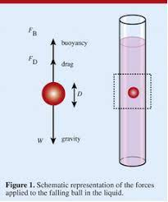
Assignment 1
The equation of motion can be written as: mdu/dt=mg-⍴Vg-6πrηu.
m=mass of sphere
u=velocity of sphere
g=gravitational acceleration
⍴=density of fluid
V=volume of sphere
r=radius of sphere
η=viscosity of the fluid

Slide 4
Assignment 1
The equation of motion can be written as: mdu/dt=mg-⍴Vg-6πrηu.
Solving the differential equation would give the analytical expression and to get the analytical answer, boundary condition u(t=0)=0 can be used. Analytical expression:
u(t)=mg/(6πrη)*(1-⍴V/m)*[1-e^(6πrηt/m)]
Numerical Method involves linear approximation: du/dt≃[u(t+Δt)-u(t)]/Δt
u(t+Δt)=gΔt(1-⍴V/m) +u (t)[ 1+6πrηΔt/m ]
This equation is then solved iteratively using a loop and the velocity at different time stamps is stored in an array.
This data is plotted.

Slide 5
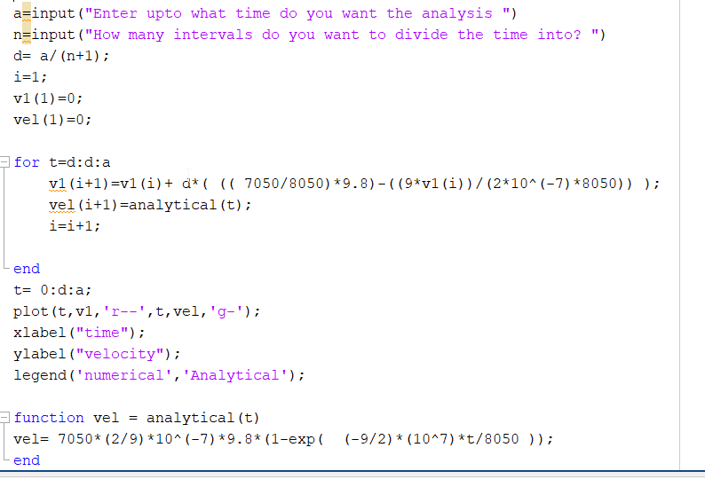
Matlab Code

Slide 6
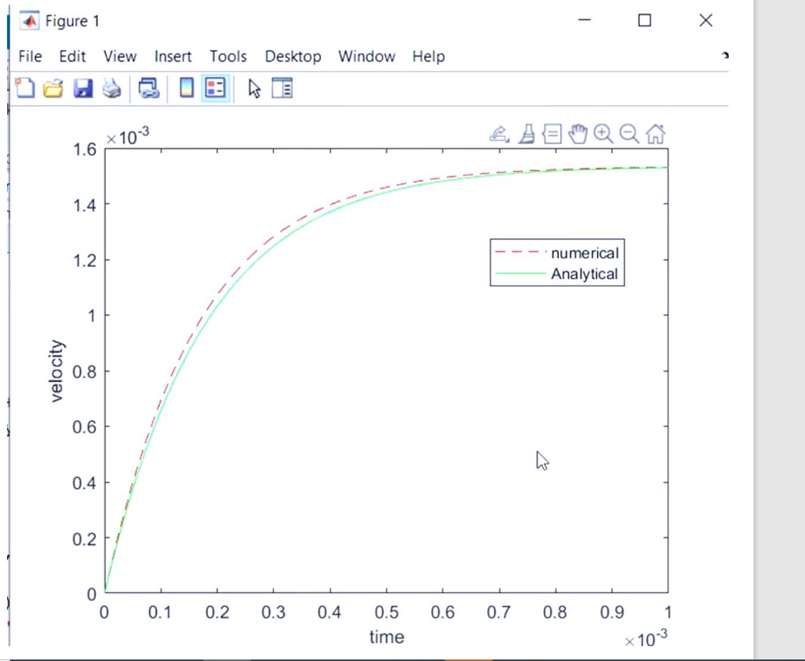
Matlab Plot

Slide 7
Brownian Motion
For the case of a free falling particle under gravity, the force driving the motion was in a fixed direction: downwards.
But for mesoscale level particles in a colloidal solution, a random zig-zag motion is observed, known as brownian motion.
Here the driving force is the brownian force, which originates due to random collisions of medium particles with the brownian particles.
Pointing direction of force is random at each moment.

Slide 8
Brownian Motion
Source:https://en.wikipedia.org/wiki/Brownian_motion

Slide 9
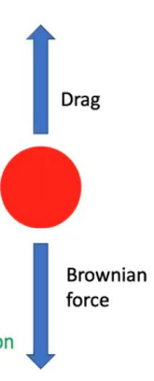


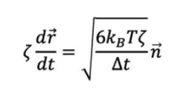
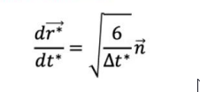
Equation of Motion
Since particle is extremely small therefore it’s inertia(mass)
Is neglected.
d
dd
Non dimensionalising the equation we get:

Slide 10

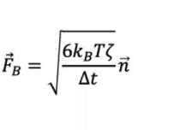
Forces on a Brownian Particle
Drag Force: Force exerted by the medium which opposes the relative motion of brownian particle.
Brownian Force: Force originating due to random collision of medium molecules with the brownian particles
Gravitational Force: Due to extremely small size of brownian particles, force due to gravity is negligible in comparison to the brownian force, hence neglected.

Slide 11

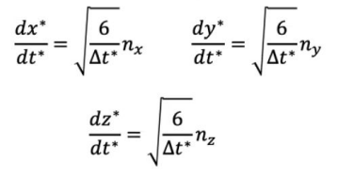
Assignment 2
Problem Statement: Assuming particle is at origin(0,0,0) at t*=0, it was asked to plot x* vs y*, and MSD vs 𝛕*, and from this plot calculate diffusivity.
We took , and used the finite difference method iteratively , as applied in previous assignment to get x*,y*,z* at time intervals multiple of t till t*=100sec.
x*(t+Δt*)=sqrt(6Δt*)nx+x*(t)
Then we calculated MSD(𝛕) for 𝛕= 0, Δt*,2Δt*,3Δt*,4Δt*,5Δt*...... 10^4Δt*.

Slide 12
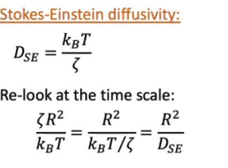

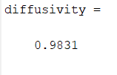
Assignment 2
We were then required to calculate Diffusivity value which was done by plotting MSD vs 𝛕*,and then fitting a line through 5 consecutive points from
𝛕* =0 using polyfit function.
Diffusivity = (slope of MSD vs 𝛕*)/6=

Slide 13
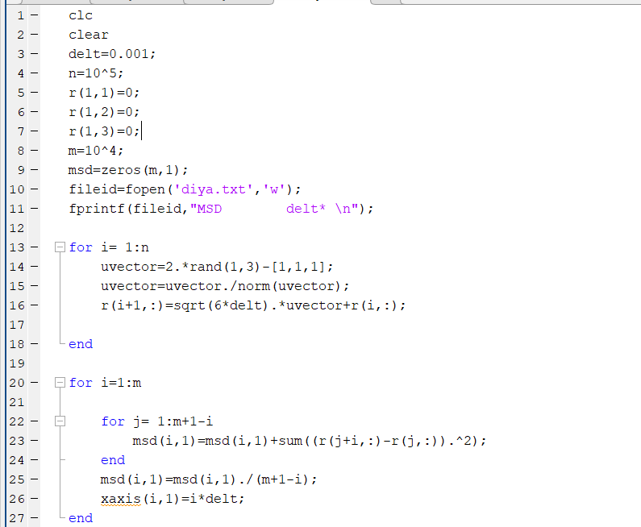
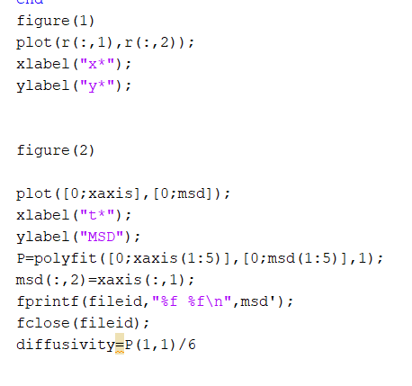
Matlab Code

Slide 14
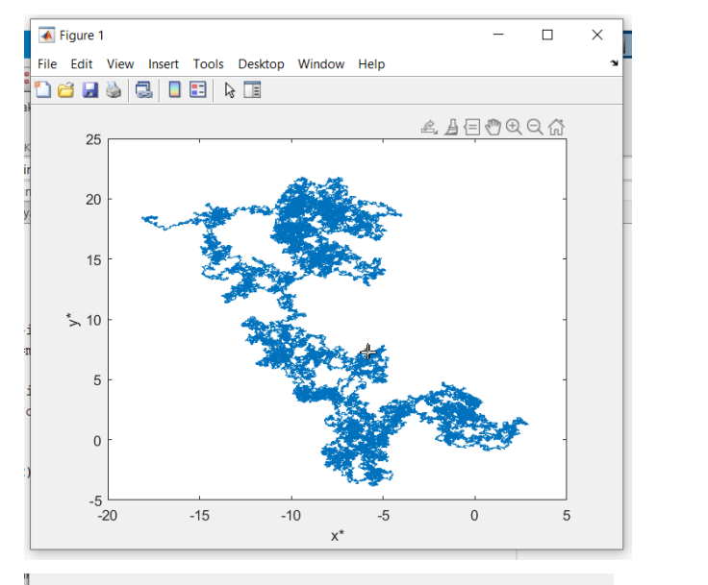
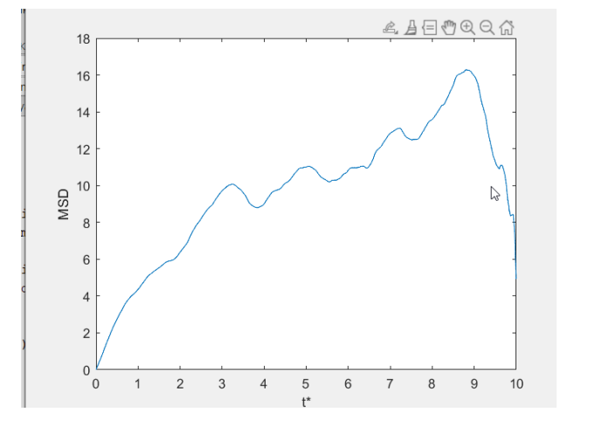
Matlab Plots
x* vs y* MSD vs 𝛕*

Slide 15
Assignment 3
Problem statement :
In this assignment we were required to plot the dimensionless distance between the 2 beads of the dumbbell model of a single polymer as a function of dimensionless time and also find the rms value of the separation between the beads.
Physics and equations :
Polymer chains practically involve around a million or more particles
It is computationally difficult to apply equations of motion individually to each particle and solve them
We therefore model our polymer chain as a dumbbell with 2 beads

Slide 16






Assignment 3
Three forces act on each bead: Drag force, brownian force and spring force.
Equation of motion

Slide 17

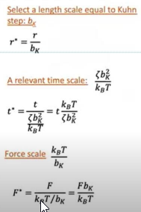
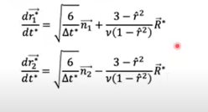
Assignment 3
Non-dimensionalising, we obtain EOS:

Slide 18

Assignment 3
We solve the dimensionless equation of motions, using similar approach as done in previous 2 assignments.
We then calculate the end to end distance between the 2 beads for different time stamps
RMS value of this distance is calculated.
We plot the dimensionless end to end
distance vs dimensionless time

Slide 19
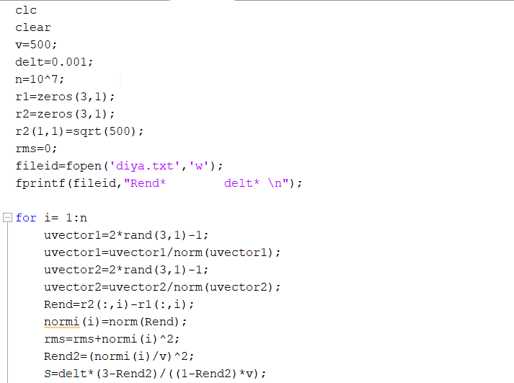
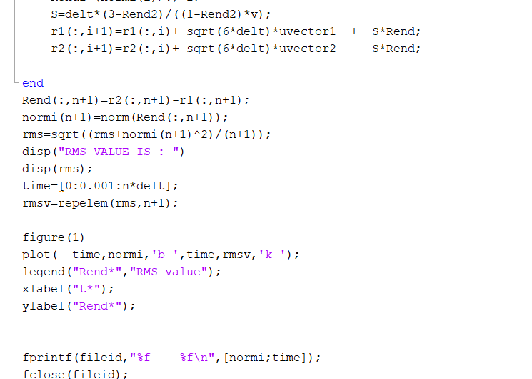
Matlab Code

Slide 20
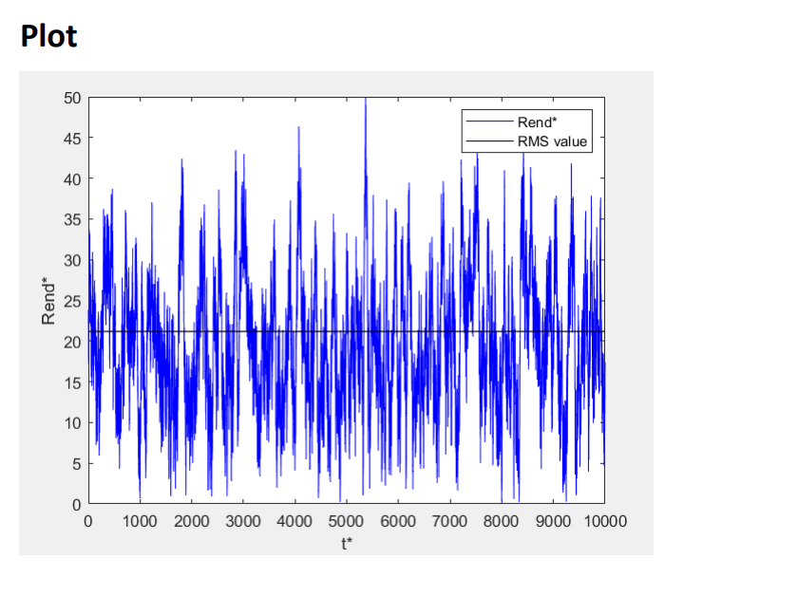
Matlab Plots

